Slide 1
Data Mining for market prediction for private health services
Case Study Ghana

Slide 2
Team Members
Ayaz Rathod
Devam Patel
Junaid Asim
Parth Patel
SM Pantho

Slide 3
Introduction
Physical and emotional wellness of citizens is the most important aspect of a nation
Health care professionals must make predictions on the market demand for health care services in the coming days
Making these prediction may be quite a challenge for the experts without proper predictive data to aid them
Medical companies today generate huge volumes of sophisticated data, including information on patients, hospital resources, illness identification, patient electronic records and medical devices which may aid in predicting the market demand of health care services especially in private hospitals

Slide 4
Con’t
Data mining is an automated way to detect or to infer from vast quantities of data obscure significant patterns.
This technology offers various methodologies for decision making, troubleshooting, research, integration, mitigation, studying, planning, diagnosis, detection, creativity, forecasts and estimates
Insights into data mining will impact prices, sales and operating performance while ensuring a high degree of service

Slide 5
Data mining process
Data mining is a task for pre-treatment, real data mining and post-treatment
During preprocessing, the data mining problems and all data sources are defined and a subset of data are generated from the accumulated data
The data collection is analyzed to ensure that the noise is eliminated, handled and transformed properly
The extracted data collection employs a methodology for data mining or a mixture of techniques appropriate for the form of information to be sought.
The final stage of the processing is the evaluation and analysis of the information found

Slide 6
DATA MINING STRATEGIES
Judgmental Forecasts
The forecasts for judgments are based on executive decisions, contracts/insurance/POS industry numbers, consumer settings, mental market projections, insights, outside (consultant) opinions and managers and staff opinion
Segmentation
Involves breaking down a problem into individual components, predicting each component by using knowledge and data and combining component forecasts.

Slide 7
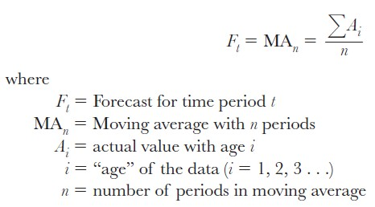
Con’t
Time-Series Approach
A time series is a set of measurement over a consistently spaced timeframe at regular intervals (such as daily, hourly, weekly, monthly, or yearly).
Moving Averages
A rolling average forecast uses various the most recent real data values, whereas a naive forecast uses data from the last time. The following equation is used to calculate the moving average projection.

Slide 8
METHODOLOGY
Research Site
Ghana is a western African nation located on the Gulf of Guinea's coast. Despite its limited size and population, Ghana is one of Africa's most powerful nations, partly due to its vast natural resources and partly because it was the first black African nation south of the Sahara to gain independence from colonial rule.
Different factors were taken into account when selecting this country as the study site, including access to information on health demand and health resources offered in the healthcare facilities. In addition, all planning issues raised in this country are relevant to the hospitals of the country.

Slide 9
Research Design
Data Understanding
The data sensitization process starts with the compilation of data. It works to familiarize itself with the data, find problems of data consistency, gain early insights into the data or recognize interesting sub-sets to form hidden intelligence theories
Data Preparation
The data collection includes all activities leading to the final data set (data being fed to the simulation tool(s)) being built from the raw data.
Modeling
modelling techniques are selected and applied and their parameters are optimized. There are typically several strategies for the same form of data mining query. Any approach requires the use of dynamic data formats

Slide 10
Con’t
Evaluation
From the data interpretation point of view, we have built one or two models at this point in the project that seem to be of high quality. Until proceeding with the final roll-out of the framework, it is important to assess the concept more in depth and review the steps to build it to ensure it meets market targets
Deployment
The completion of the concept is not necessarily the end of the project. The knowledge collected must typically be arranged and distributed in a way that the customer understands

Slide 11
Tools:WEKA
Overview of WEKA
Waikato Environment for Knowledge Analysis is a free and open-source platform for machine learning algorithms and data mining activities.
WEKA includes data pre-processing, sorting, Decision Trees, Artificial Neural Networks, data mining, statistical analytics, and logic regression, as well as a collection of visualization methods. This would be the project's preferred tech tool

Slide 12
Data Collection Methods
Interviews
Online interviews were used to gather market participants' in-depth perspectives, viewpoints and anecdotal proof. The interviewer will take time and time to conduct interviews and equipment to record and transcribe interviews. There were also extensive interviews in which the interviewer did not hold to a number of questions.
Document Studies
Existing documents reveal something about a location the cannot be observed or noted in a more general way
The documentation available revealed more on the location and the population that which interviews could not capture

Slide 13
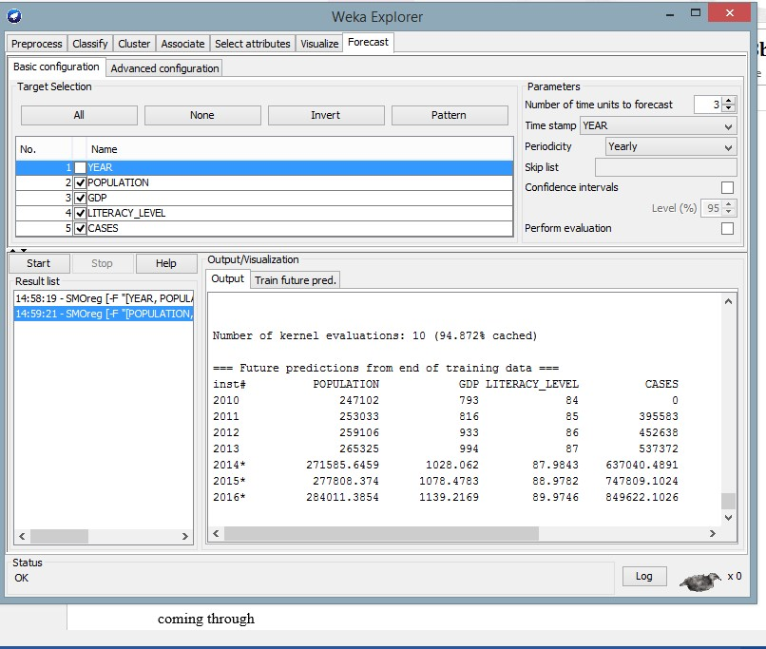
System Evaluation
Unit testing
This testing level was designed to ensure that various subsystems could bind to databases and read and manipulate data.
Tasks in Unit Testing

Slide 14
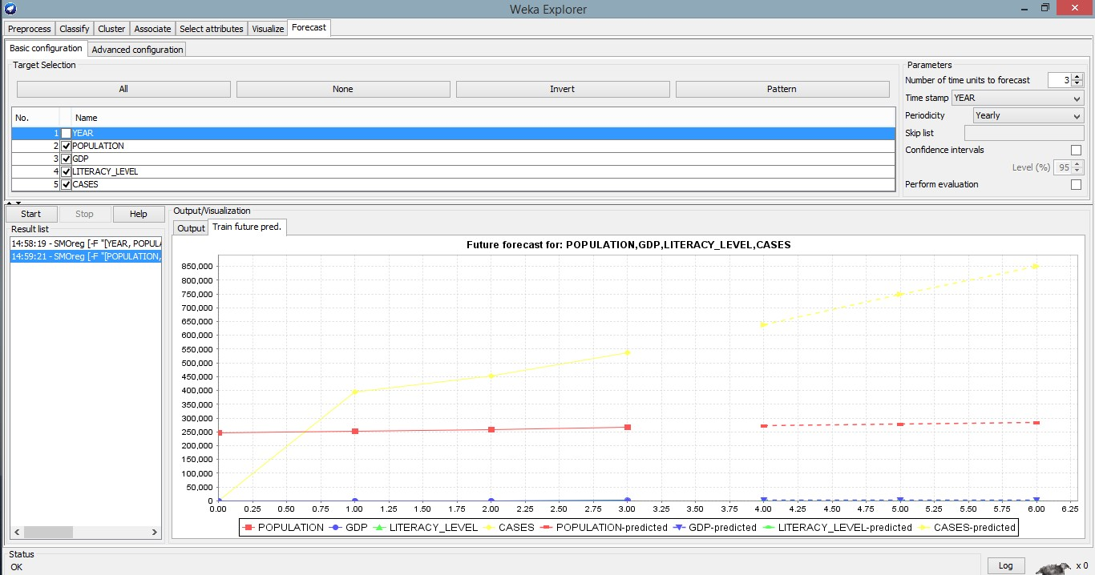
System testing
Device maintenance was performed to ensure that the system was performing as expected and producing verifiable outcomes. The predictions were being tested against the data to ensure that the correct production was being generated.

Slide 15
Deployment
Any private hospital in Ghana that wants to use the demand forecasting feature and decision support mechanism in this project will use this solution. The deployment phase will range from a basic report generation to a sophisticated application of a repeatable data mining method and real-time integration of data sources in specialized servers and network networks, depending on the hospital's goal

Slide 16
Factors affecting the forecast results
Income
The outcomes vary if the GDP stays stable versus if power increases marginally. This demonstrated that the forecasting process accounted for several factors in the forecasted outcomes.
Population and population growth
The demand for overall outpatients was influenced by population fluctuations and growth, as seen in the forecast results
Average Literacy Levels
This affects the findings because it dictates the average ability to go to private clinics for treatment.

Slide 17
CONCLUSIONS & RECOMMENDATIONS
Today's healthcare administrators and planners in Ghana must make future healthcare service delivery decisions without understanding what will happen.
This is due to the lack of an insightful and sophisticated infrastructure capable of mining big data and generating analytical patterns on healthcare demand forecasting in Ghana
Forecasts will enable managers to forecast potential demand and make appropriate plans.

Slide 18
Con’t
This project's key goal was to look at data mining to forecast demand for private health services in Ghana
In the real world, successful information discovery methods and data mining methods are at the heart of constructing any strategic research and forecasting models from big data in various industries.
WEKA, a data mining and forecasting method used in this project and prototype development, has proven to be extremely effective in forecasting from big data in the medical field. The method can perform complex tasks such as forecasting future patterns by combining several variables and calculating them appropriately to arrive at forecast estimates
The predicted results must seem to be precise and practical to be trusted. Forecasting of real known data was used to validate this model. We set out to predict the outcome about 2019, for which the results were known, and we had data from 2016 to 2019. The model predicted the actual outcomes with a marginal error of 7.9%, projected to decrease as more training data is collected.

Slide 19
Recommendations
This model's accurate operation is highly dependent on the central availability of accurate records for all medical problems handled by all hospitals in the country. My advice to the government and the Ghana Health Information System implementers in the Ministry of Health is to collect all data from all hospitals around the country to improve forecasting models' performance based on those data. This would help the further developments in this model and provide more complex situations with Ghana's well-being.

Slide 20
References
Cios, K. J., & Moore, G. W. (2002). The uniqueness of medical data mining. Artificial intelligence in medicine, 26(1-2), 1-24. https://www.sciencedirect.com/science/article/pii/S0933365702000490
Lin, A. X., Ho, A. F. W., Cheong, K. H., Li, Z., Cai, W., Chee, M. L., ... & Ong, M. E. H. (2020). Leveraging machine learning techniques and engineering of multi-nature features for national daily regional ambulance demand prediction. International journal of environmental research and public health, 17(11), 4179. https://www.mdpi.com/1660-4601/17/11/4179
Milovic, B., & Milovic, M. (2012). Prediction and decision making in health care using data mining. International Journal of Public Health Science (IJPHS), 1(2), 69-78. https://www.academia.edu/download/33572666/1380-4163-1-PB_(1).pdf
Moro Visconti, R., & Morea, D. (2019). Big data for the sustainability of healthcare project financing. Sustainability, 11(13), 3748.
https://www.mdpi.com/2071-1050/11/13/3748
Sun, W., Cai, Z., Liu, F., Fang, S., & Wang, G. (2017, October). A survey of data mining technology on electronic medical records. In 2017 IEEE 19th International Conference on e-Health Networking, Applications and Services (Healthcom) (pp. 1-6). IEEE. https://ieeexplore.ieee.org/abstract/document/8210774/

